Slide 1
Healthy or Polluted Environment! Erasmus+ KA210-SCH

Slide 2
What is Erasmus+ Program ?
Erasmus+ is an EU program supporting education, training, youth, and sport in Europe.
The Program provides opportunities for students, teachers, and institutions to learn abroad in Europe.
The Program helps students to focus on personal growth, cultural exchange, and skill development.

Slide 3
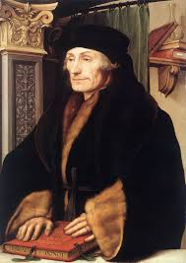
Brief History of Erasmus+
1987: The Erasmus program was launched by the European Commission.
Named after Erasmus of Rotterdam, a Renaissance scholar who traveled across Europe to learn.
Originally focused on higher education, allowing university students to study abroad.
2014: The program expanded and became Erasmus+, including school education, vocational training, and youth projects.
More than 10 million people have benefited from Erasmus+ since it began.
Erasmus of Rotterdam

Slide 4
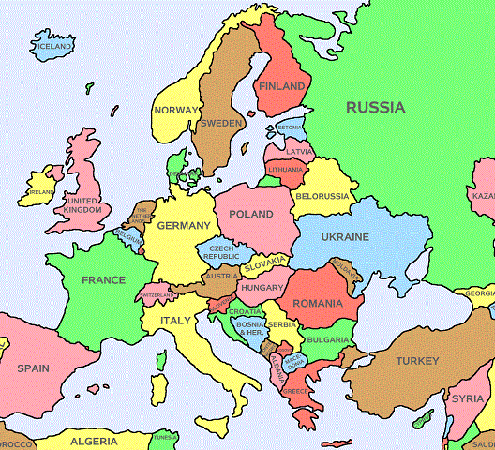
Participating Countries
All European union Countries, Norway, Iceland, North Macedonia, Liechtenstein, Republic of Serbia and Republic of Türkiye

Slide 5
Our project : Healthy or Polluted Environment (H.O.P.E!)
Each Erasmus+ project has a topic. Our project was about nature and environment.
The participating schools were Narva Soldino Kool of Estonia, Dr. İlhami Tankut Anatolian High School of Antalya, 15 Temmuz Şehitler Anatolian High school of İzmir and National University of Science and Technology Politechnica Bucahrest of Romania.

Slide 6
Our project : Healthy or Polluted Environment (H.O.P.E!)
This Project aimed to;
- raise awareness about environmental problems and develop green skills,
- create attitude changes in consumption habits and encourage to take responsibility in environmental sustainability,
- build a waste management plan for our schools,
- foster cultural recognization and improve language skills
- Enhance collaboration, team work, and entrepreneurship
- improve web and technology skills

Slide 7
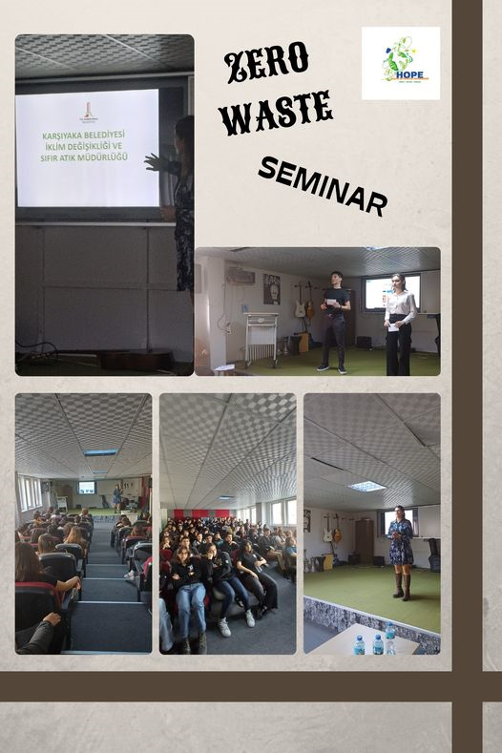
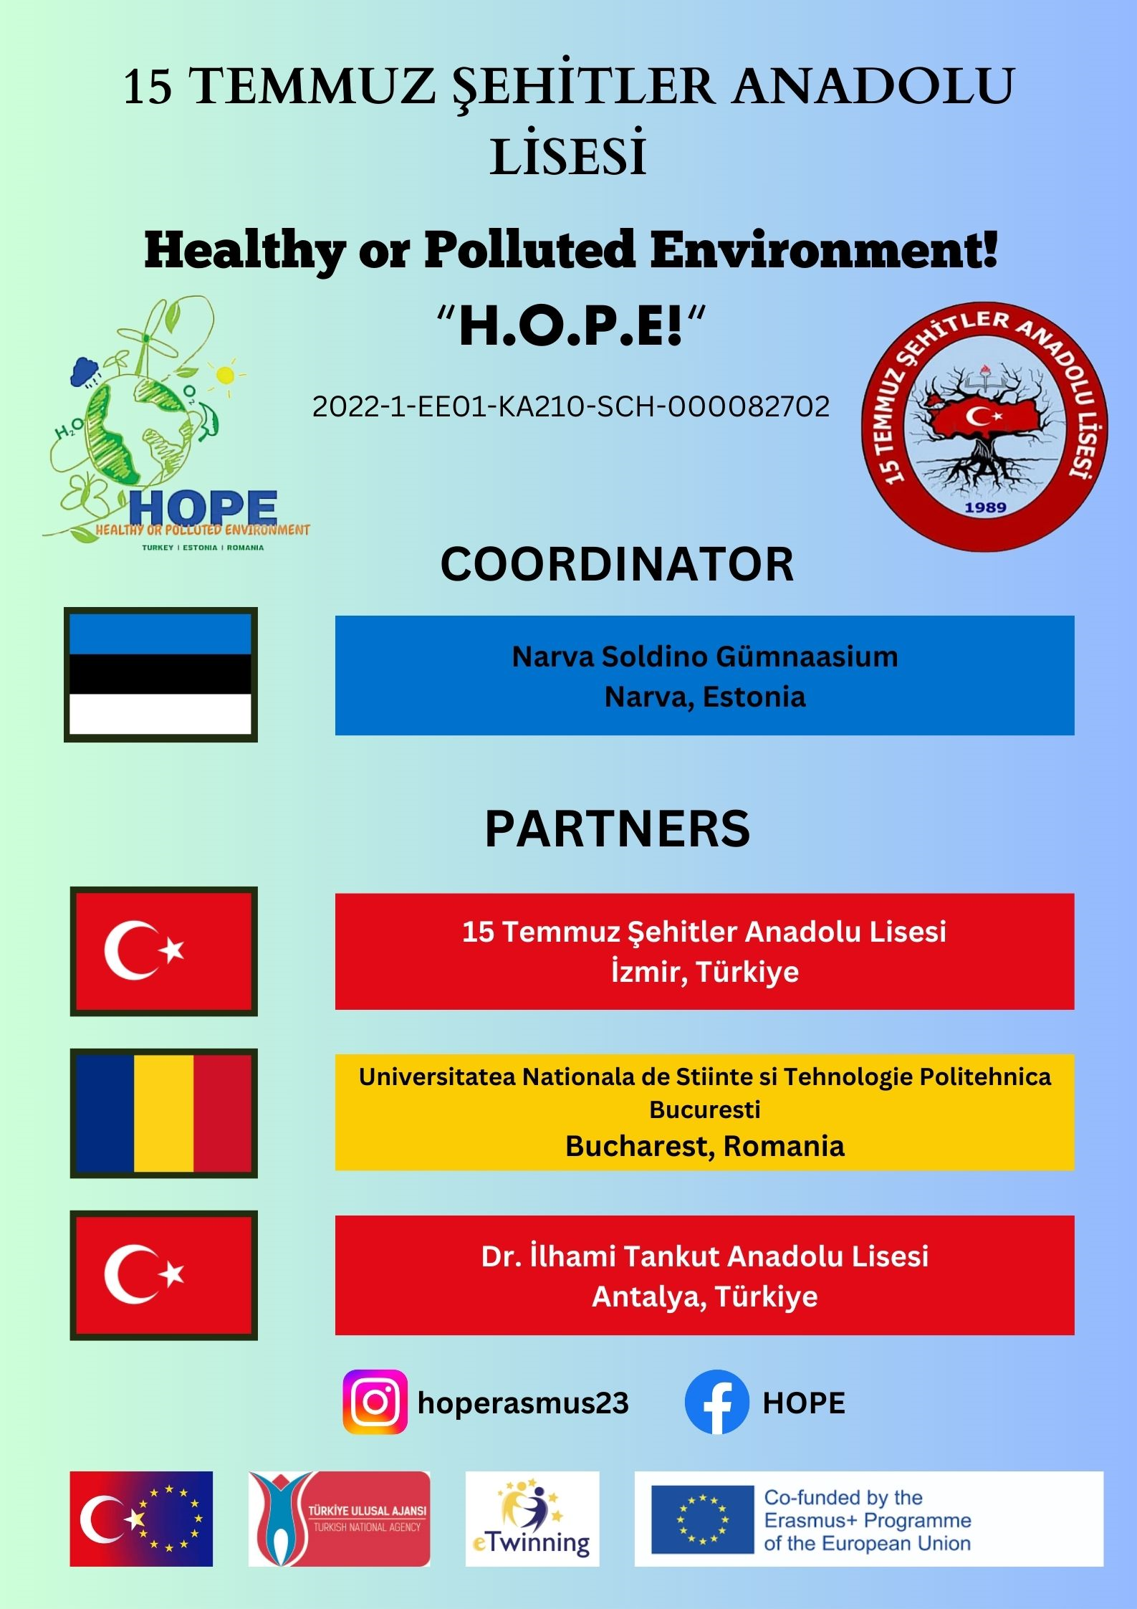
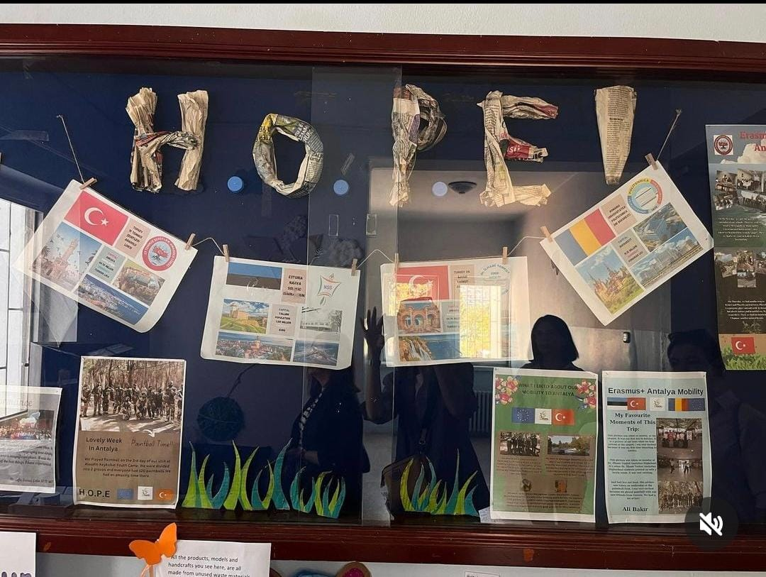
Our project : Healthy or Polluted Environment (H.O.P.E!)

Slide 8
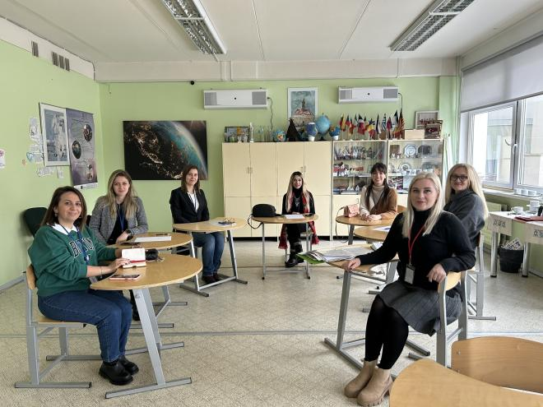
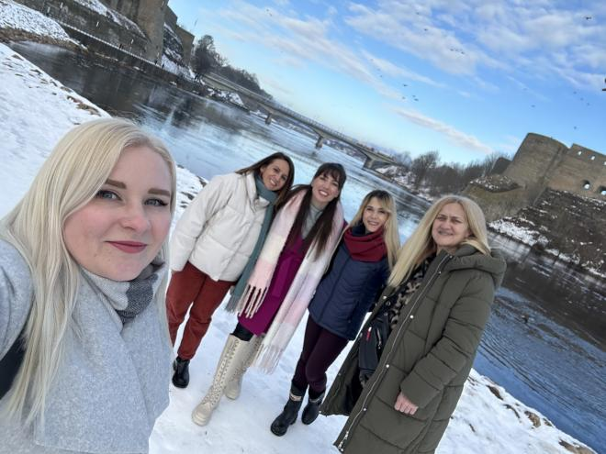
Mobilities in the Project
First of all, a teachers’ meeting was held in Narva, Estoniain February, 2022. Two teachers from our school joined the meeting and represented our school there. Project topic was discussed and a task distribution was made.

Slide 9
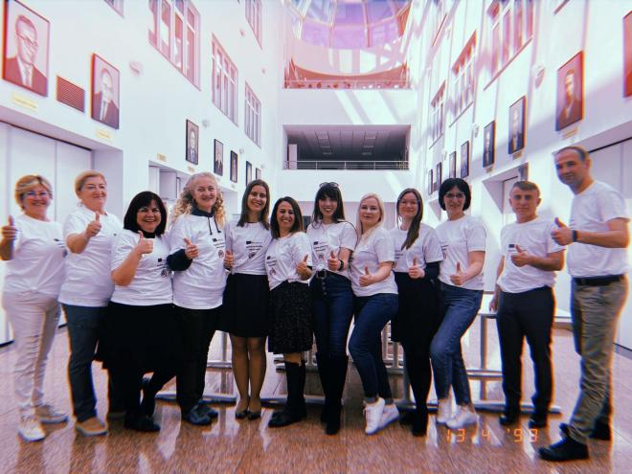
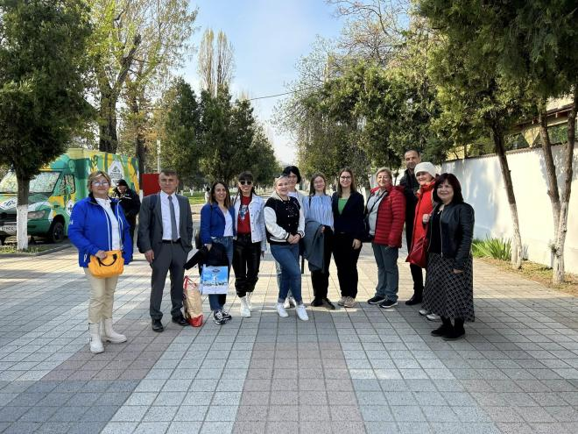
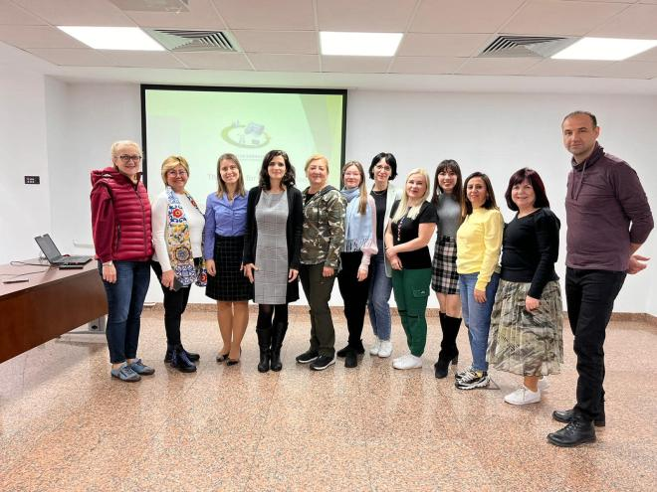
Mobilities in the Project
Secondly, a teacher training was done in Bucharest, Romania in April, 2023. Four teachers from our school attented that training and made many studies at Bucharest Politechnica University.

Slide 10
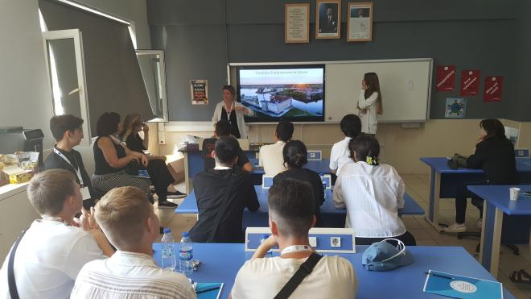
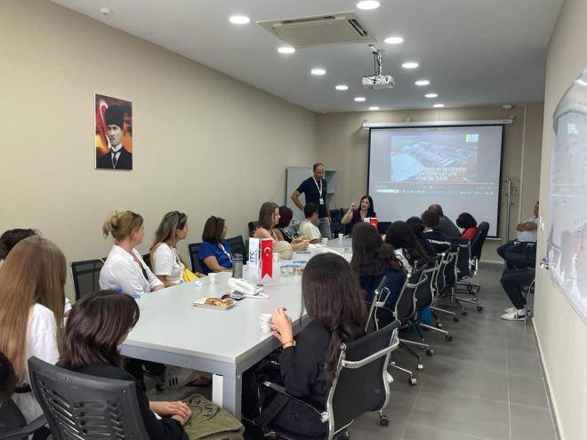
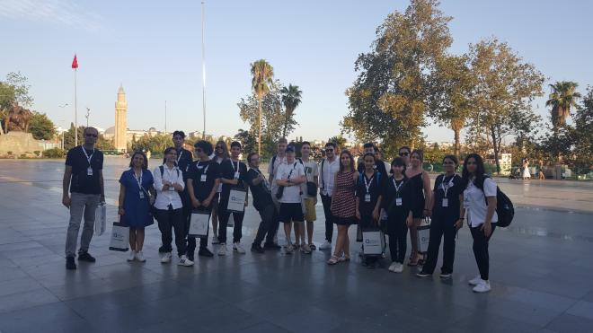
Mobilities in the Project
In 2023- 2024 academic year, stusdents mobilities started and a team of 4 students and two teachers went to Antalya to complete learning, teaching and training activity about «Tourism & Greenhouse Farming and Waste». Many cultural trips and activities were done besides the workshops related to the project topic.

Slide 11
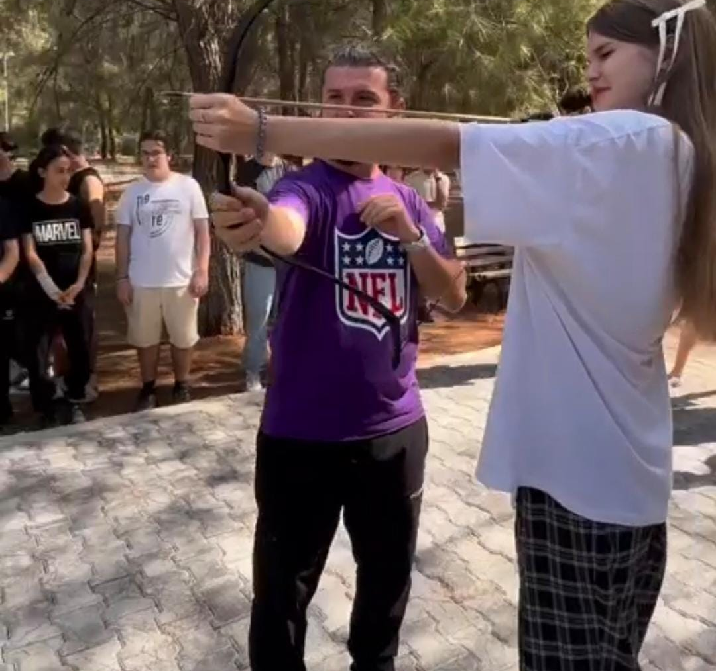
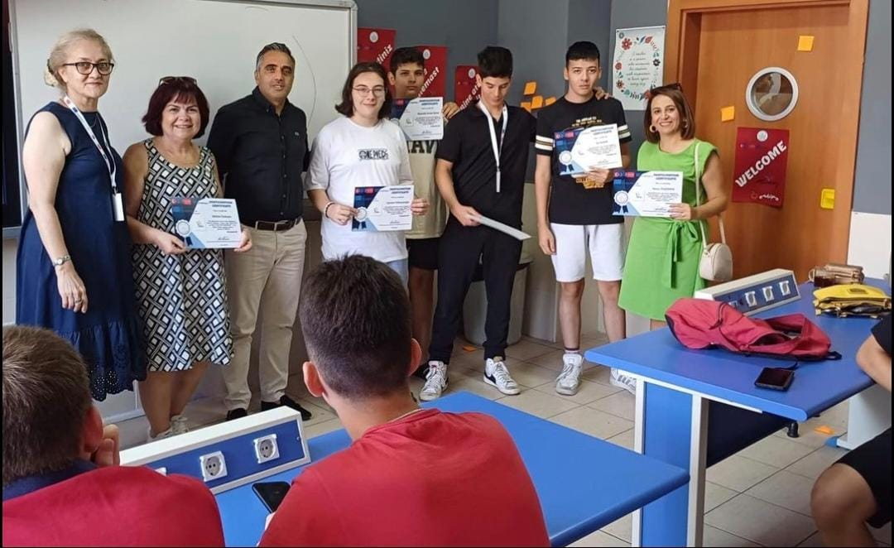
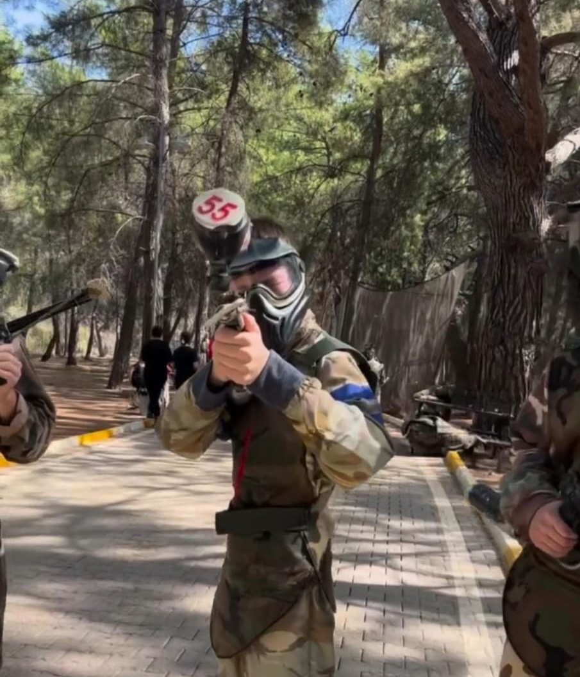
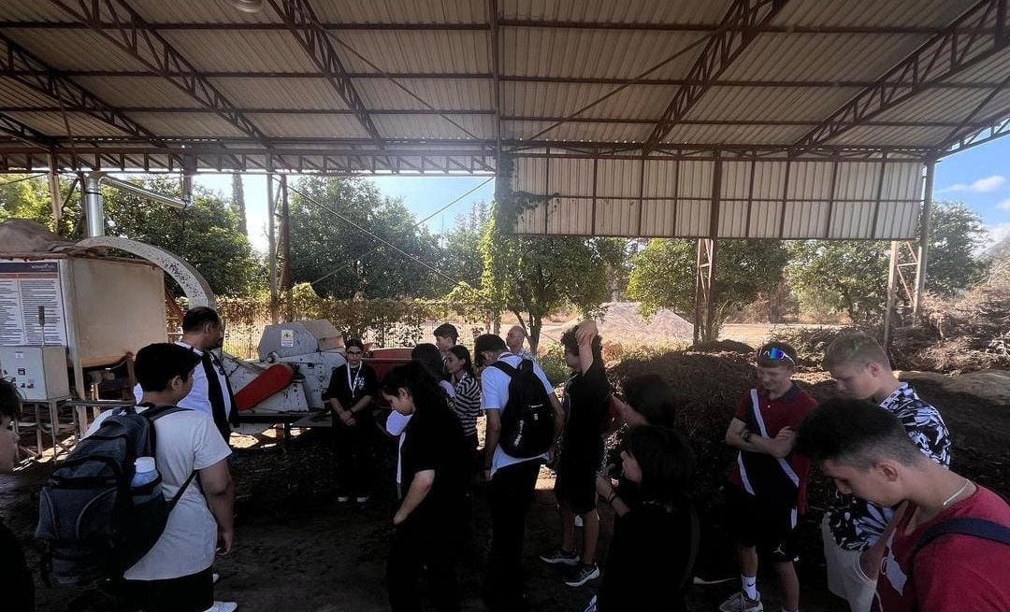
Antalya Mobility

Slide 12
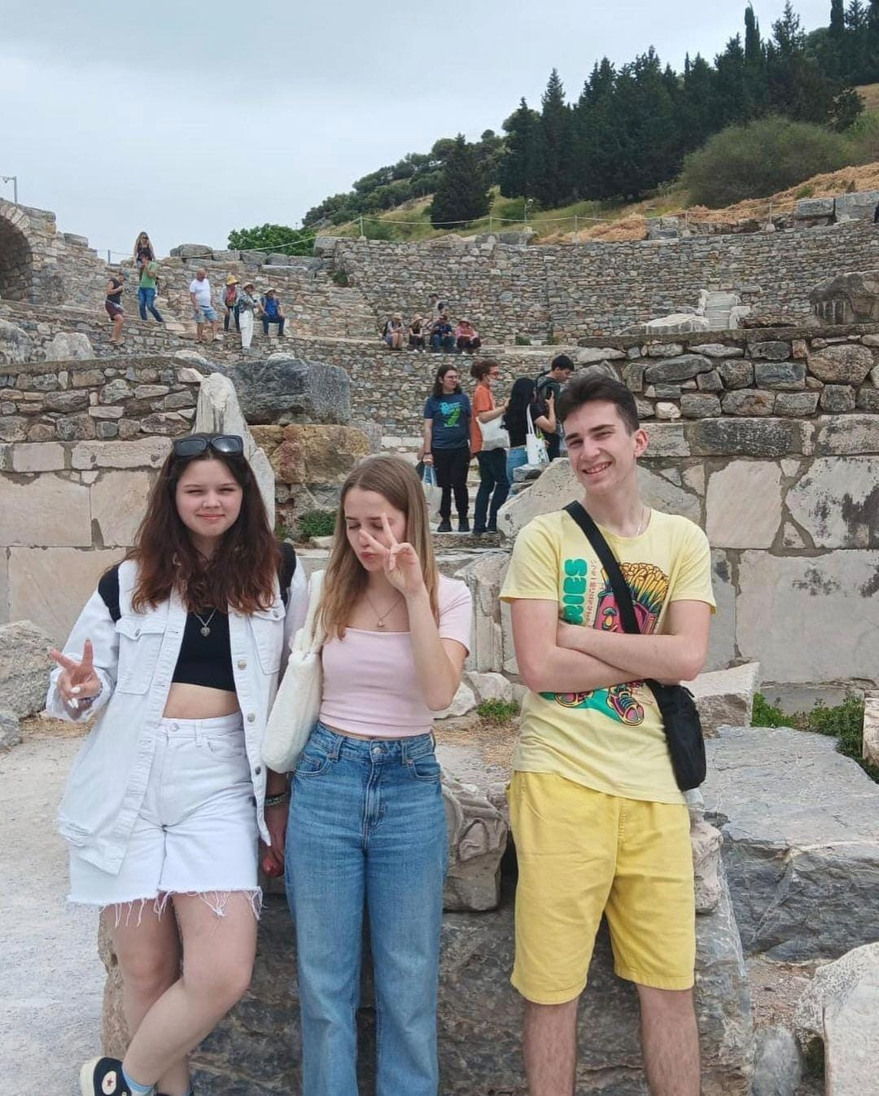
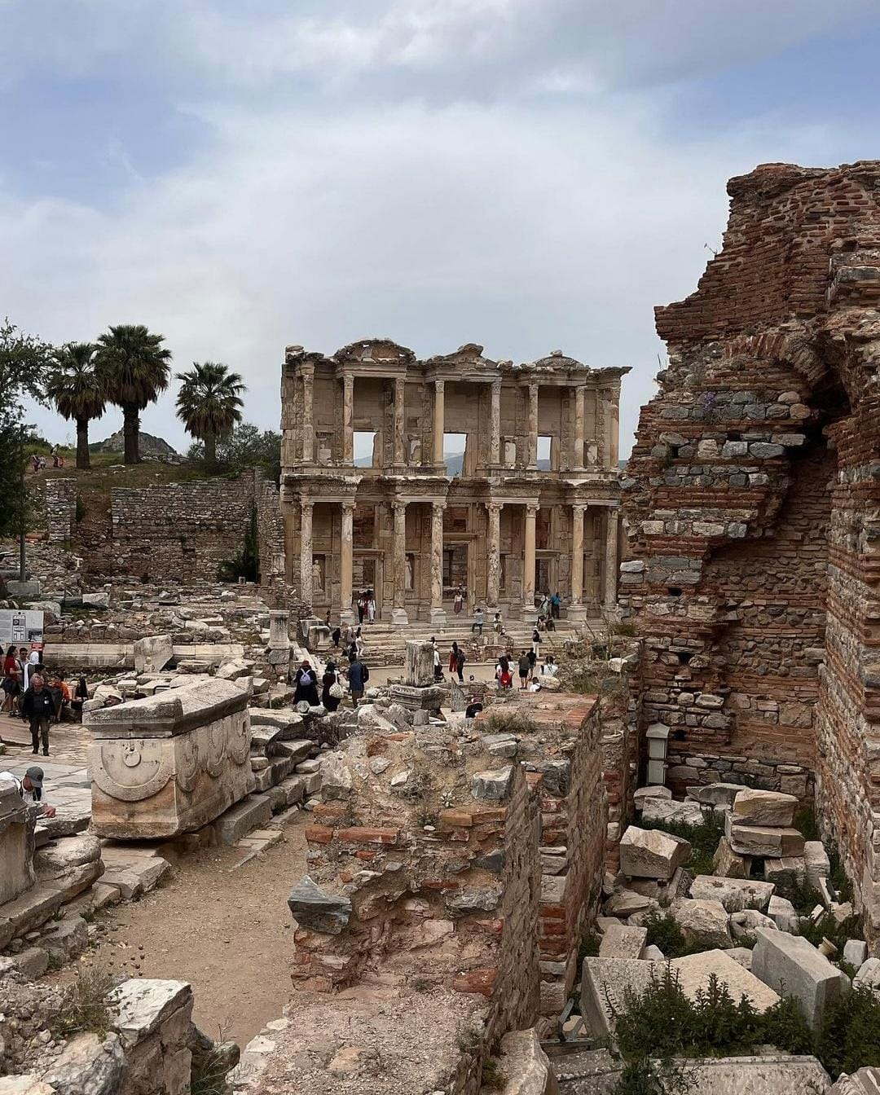
Mobilities in the Project
Then, in April of 2024, students and teachers from both Antalya and Estonia arrived at our school for the project :
We made sure that the partners had a warm welcome and experienced İzmir with all of its beauty with showing them all the places that are essential for visiting izmir like the Clock Tower, Kemeraltı Bazaar, the Elevator, Ephesus and Şirince.

Slide 13
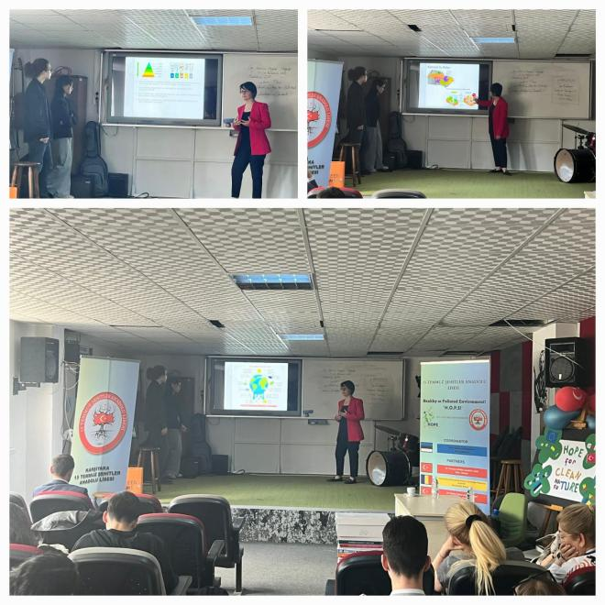
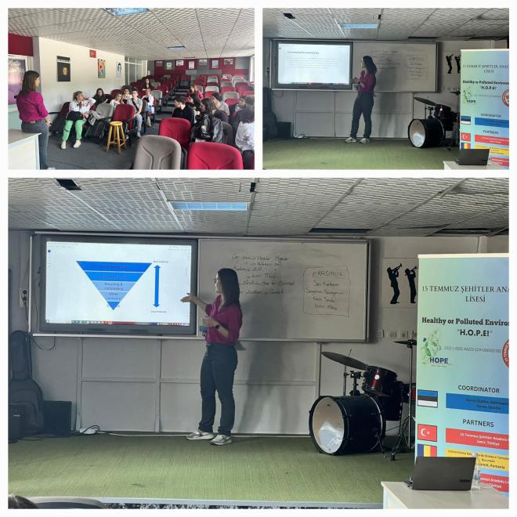
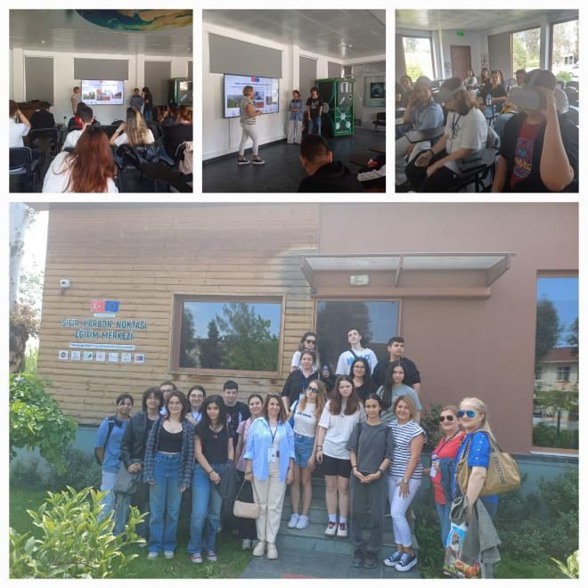
İzmir Mobility
Apart from cultural trips, we had many seminars, workshops and activities on «Urbanization and Waste».

Slide 14
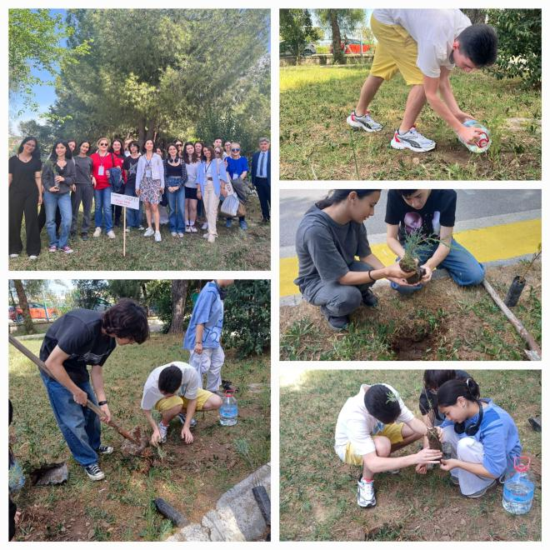
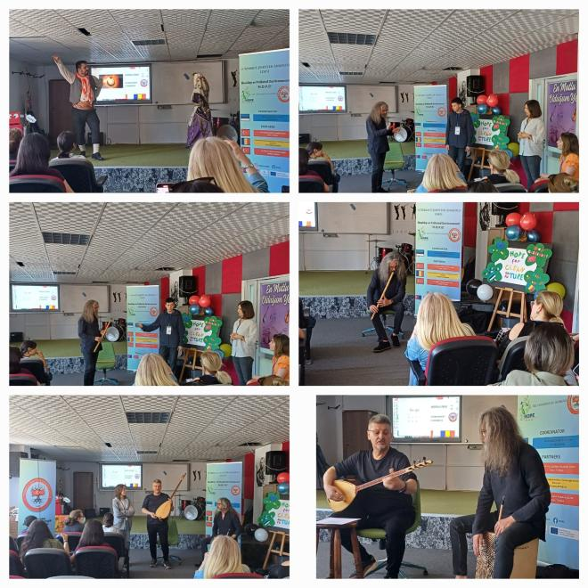
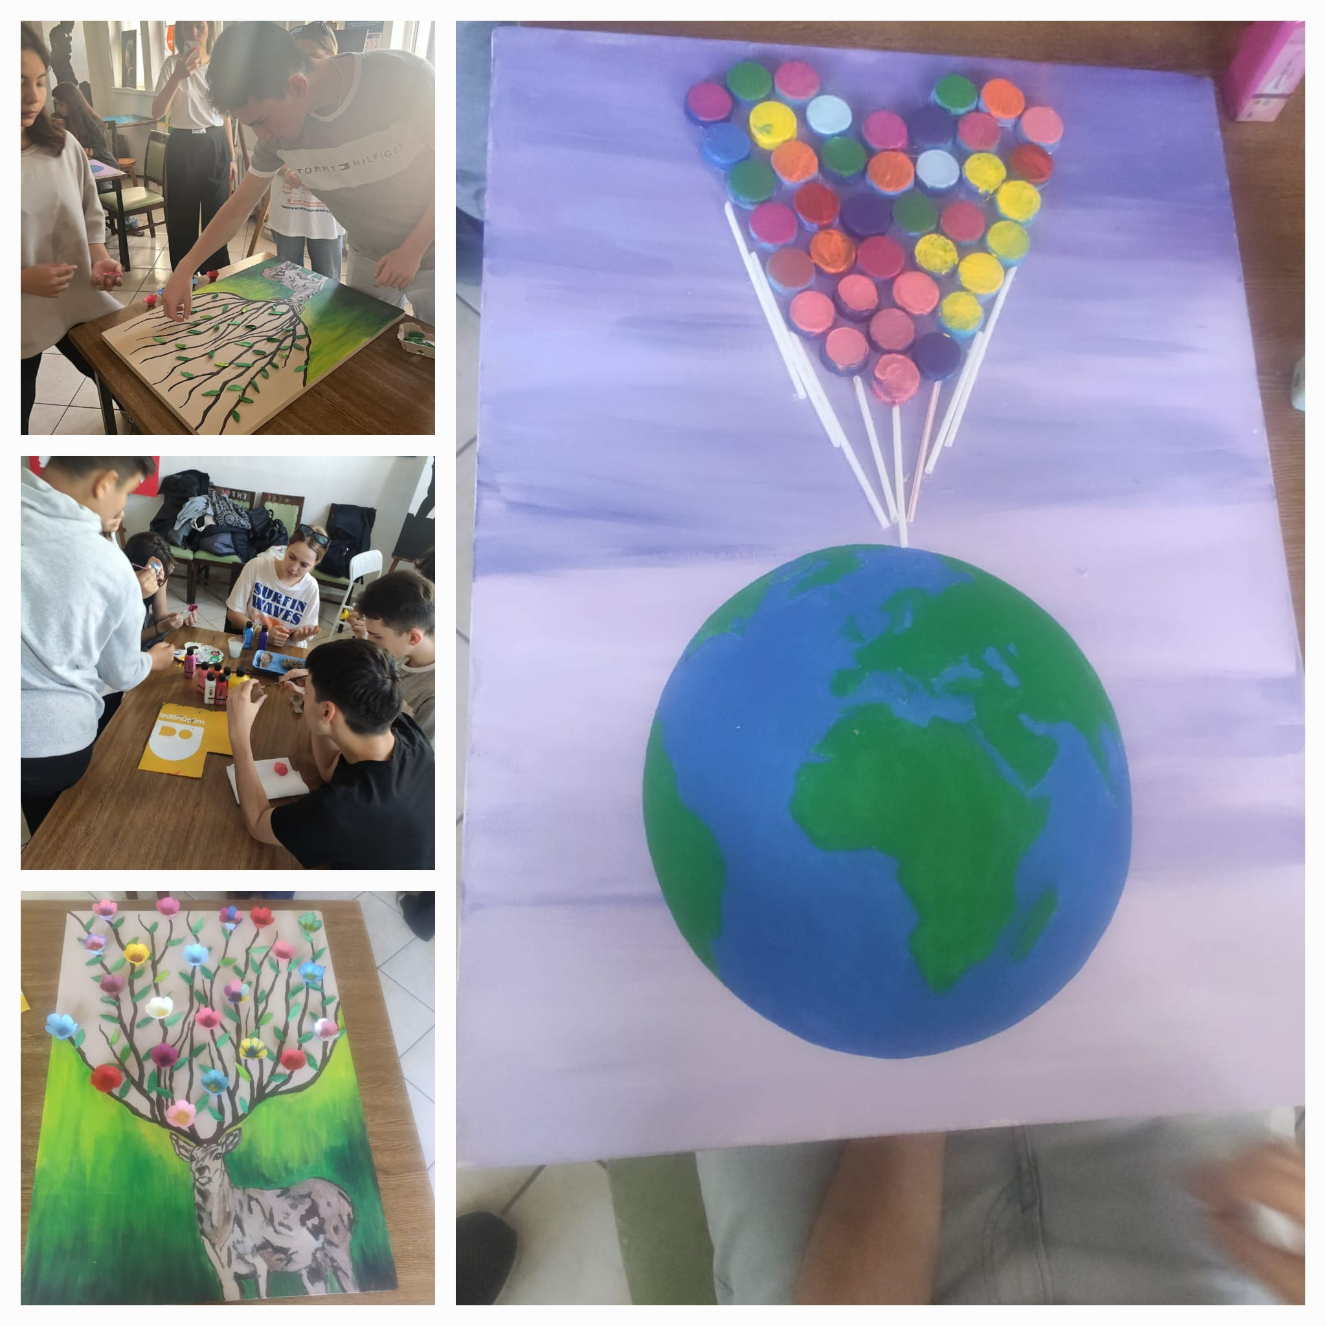
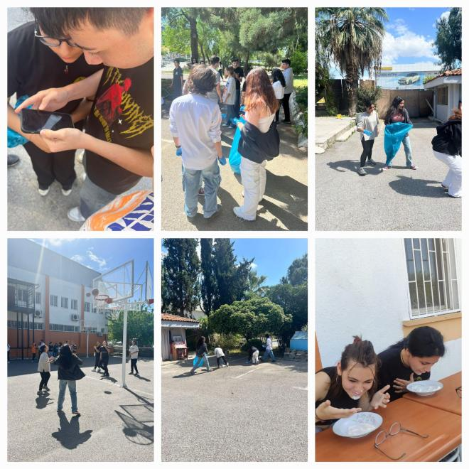
İzmir Mobility
We planted trees, did some art out of waste, played an environmental game and enjoyed Turkish music and dance.

Slide 15
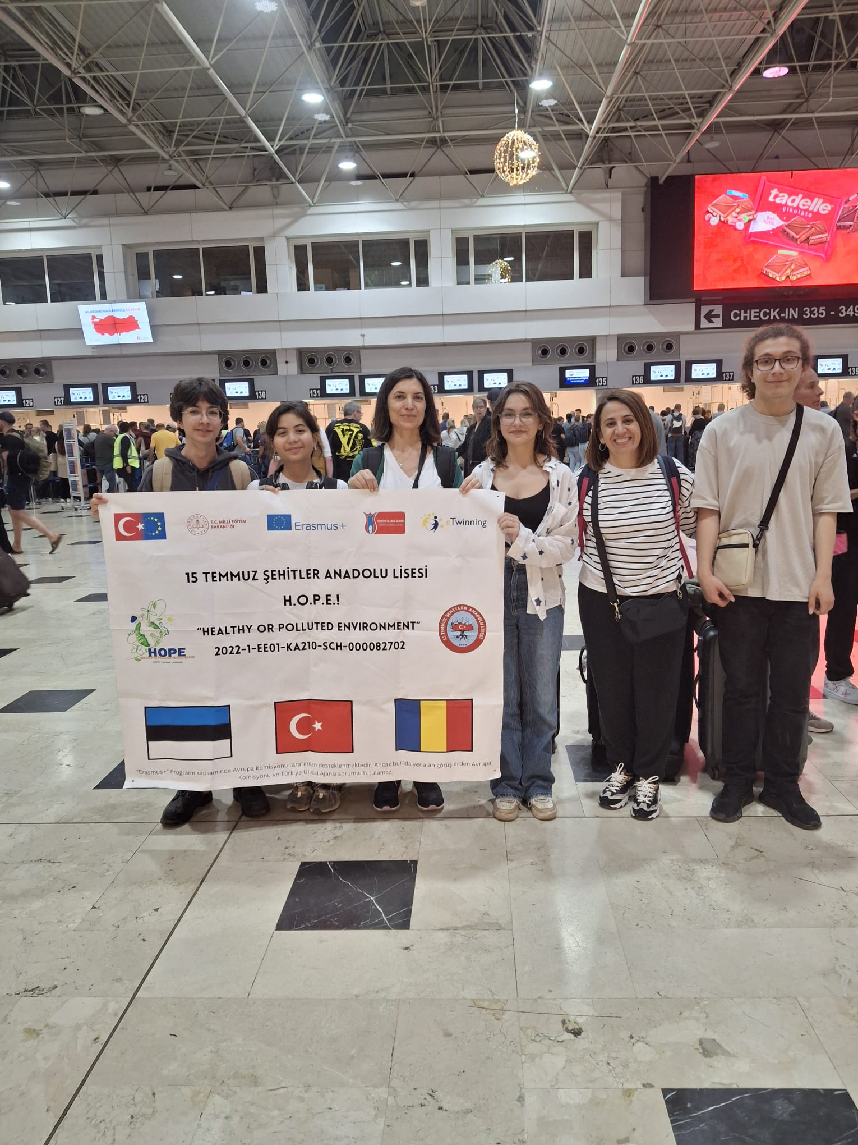
Mobilities in the Project
And Finally 4 students and 2 teachers from İzmir (us) and 4 students from Antalya went to Narva, Estonia. We were delighted to experience Estonia and made an impact about the environment about the topic «Industrialization and Waste»
https://www.youtube.com/shorts/QOqvgF_MUjg

Slide 16
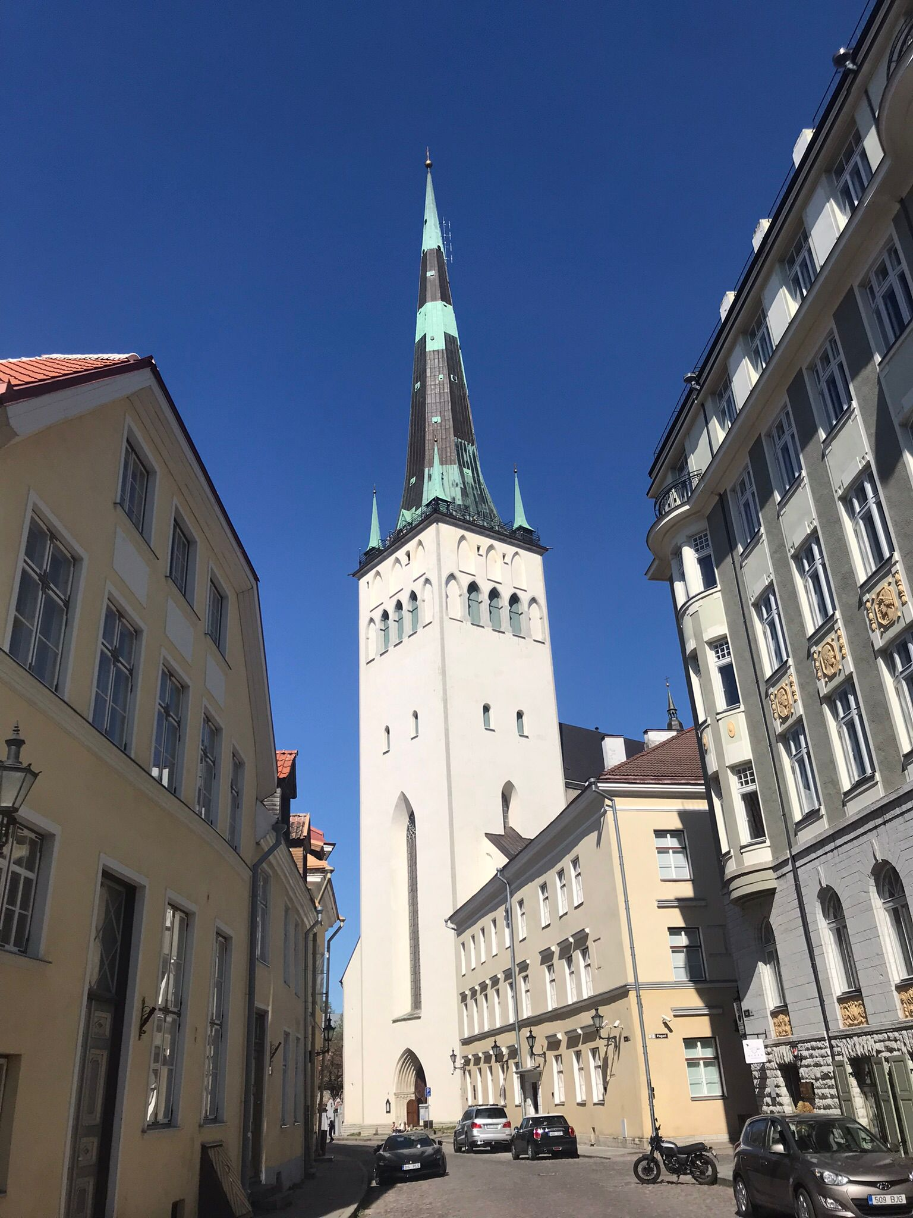
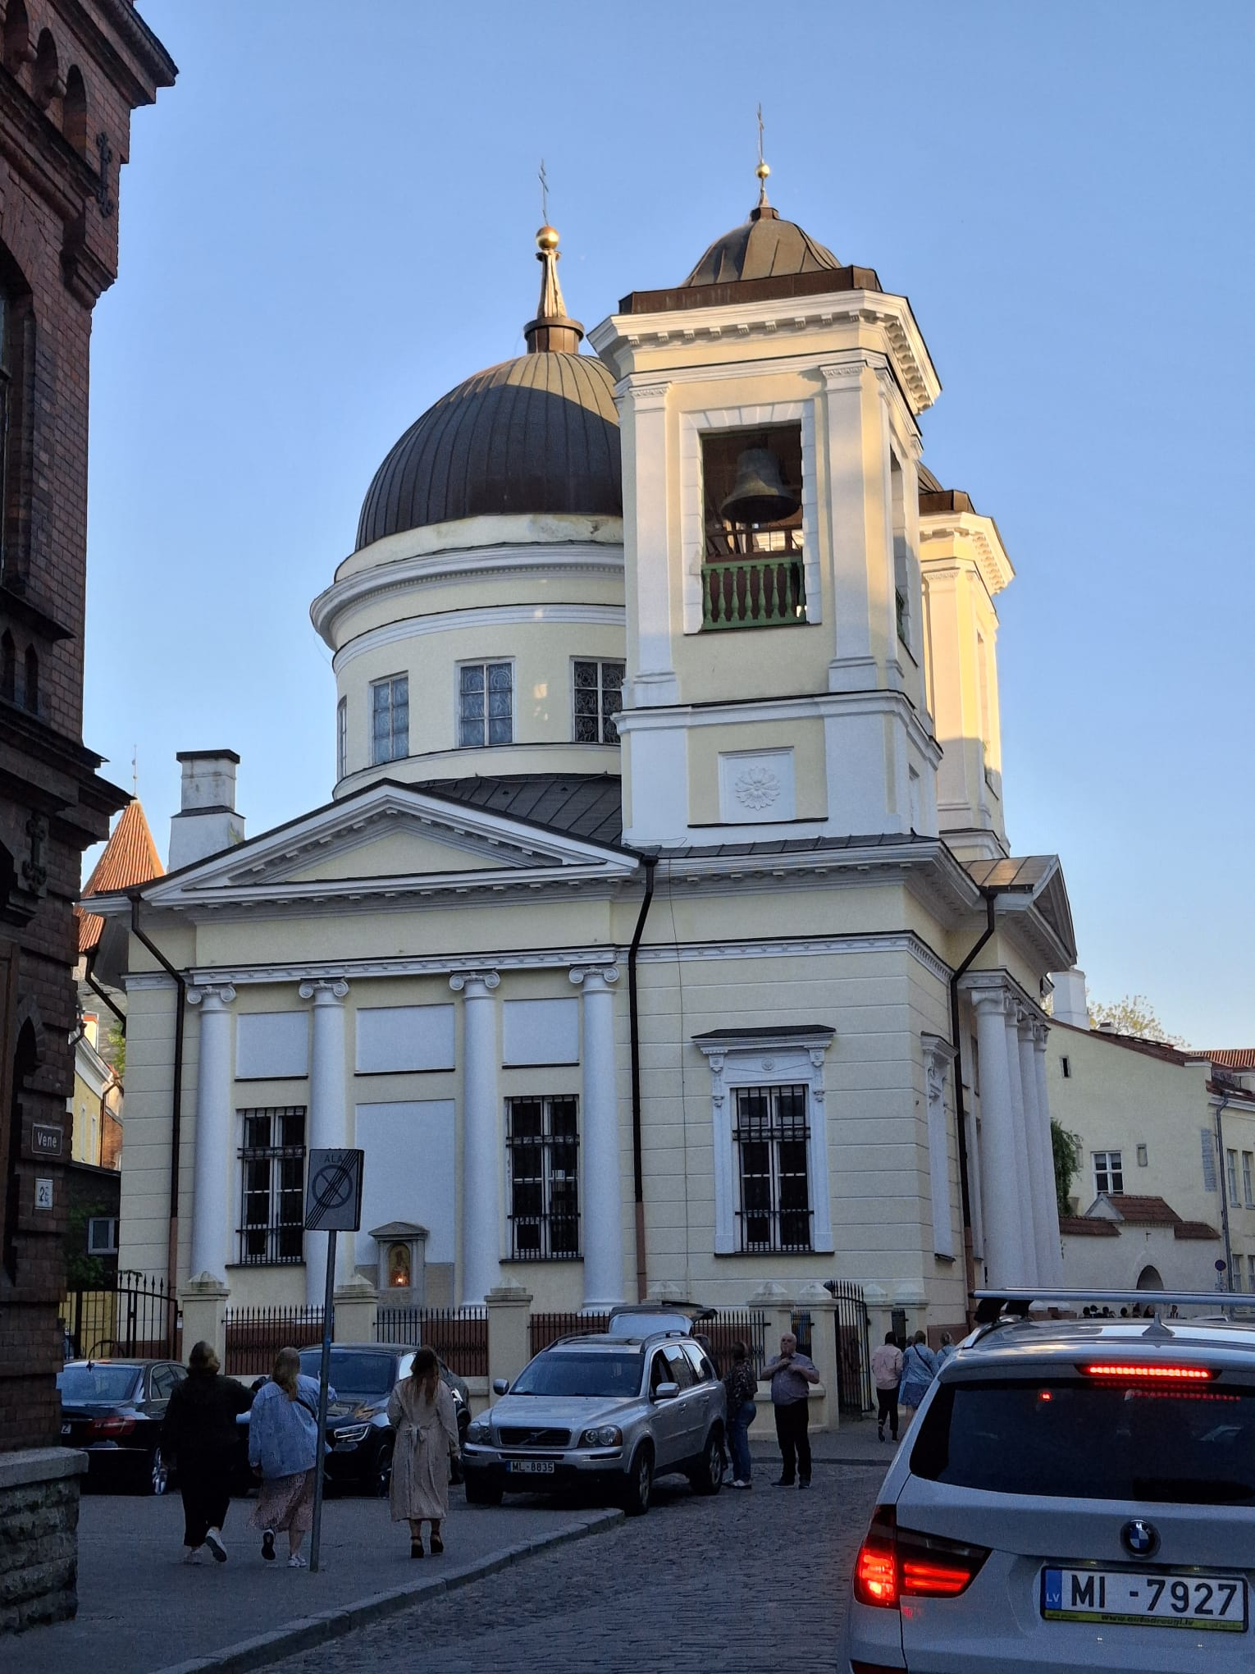
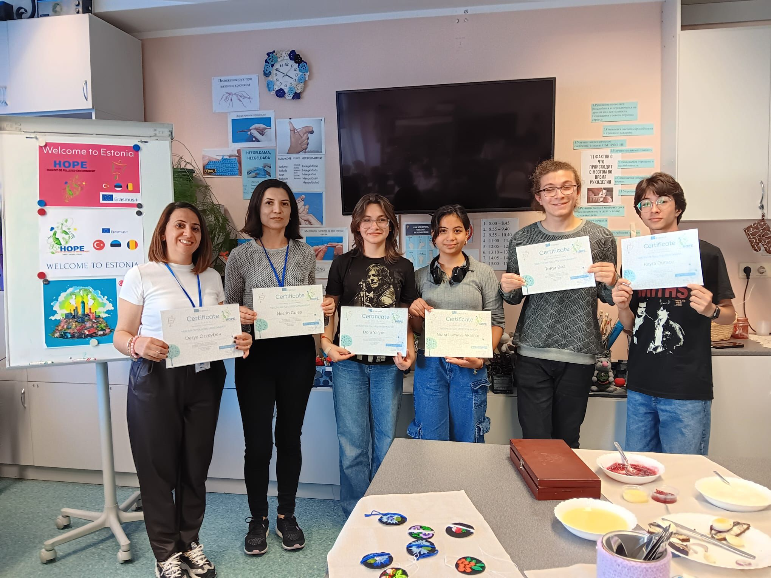
Estonia Mobility

Slide 18
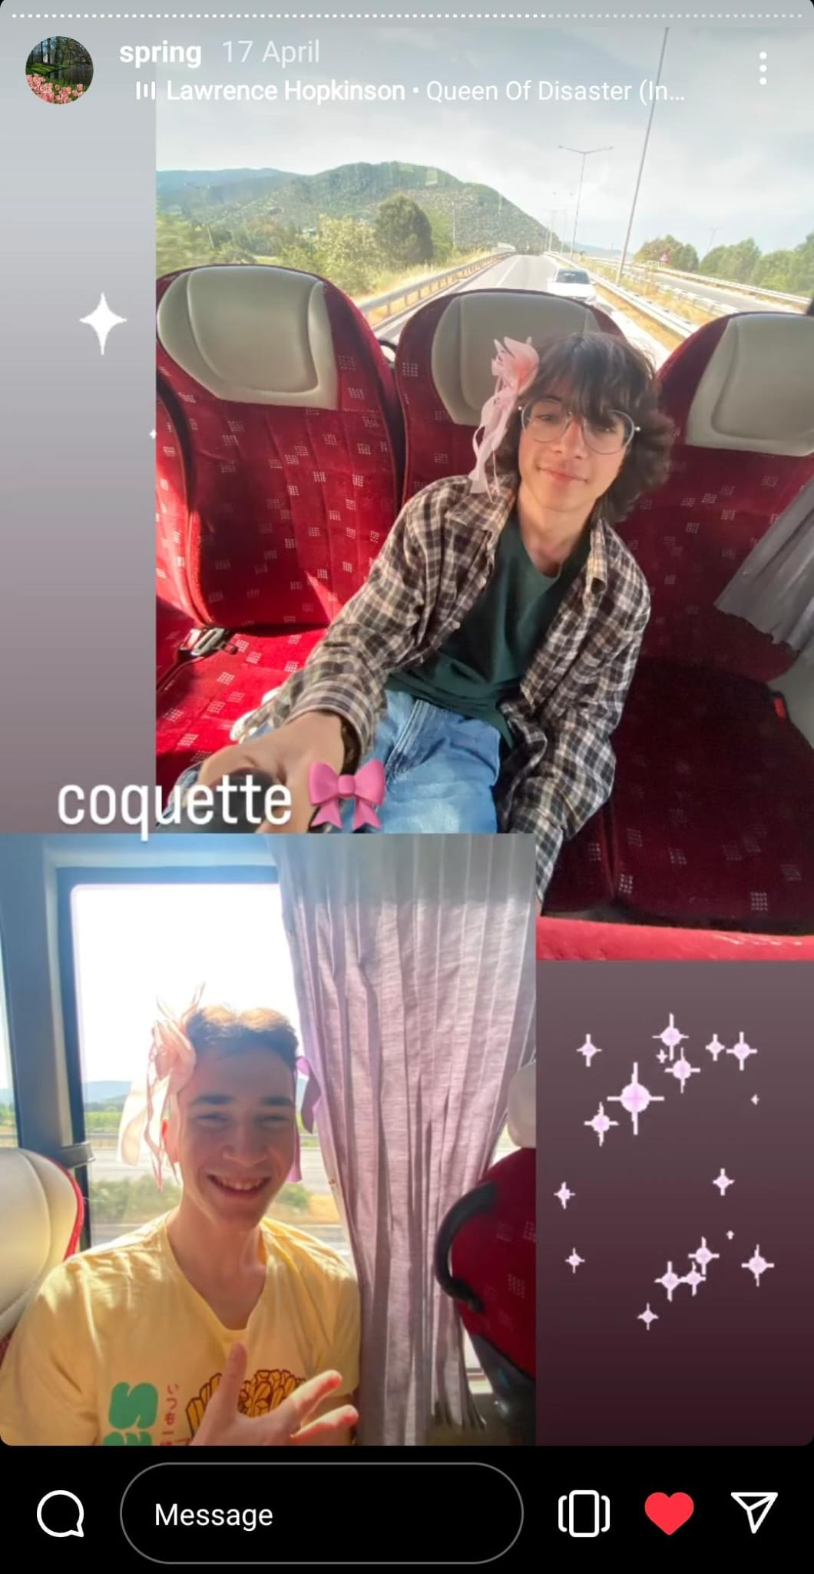
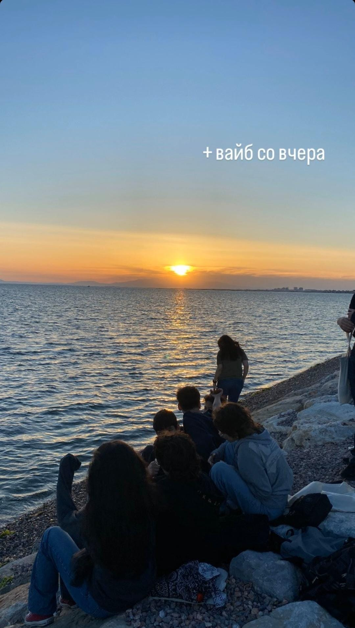
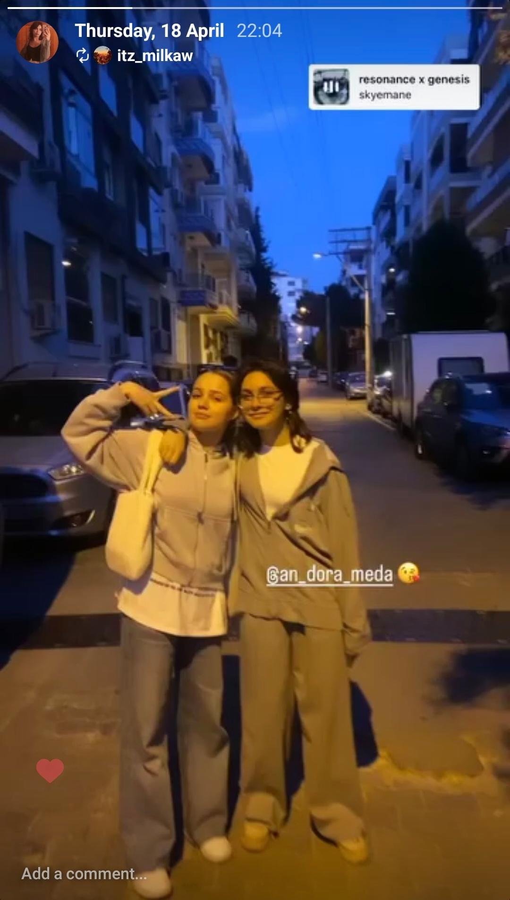
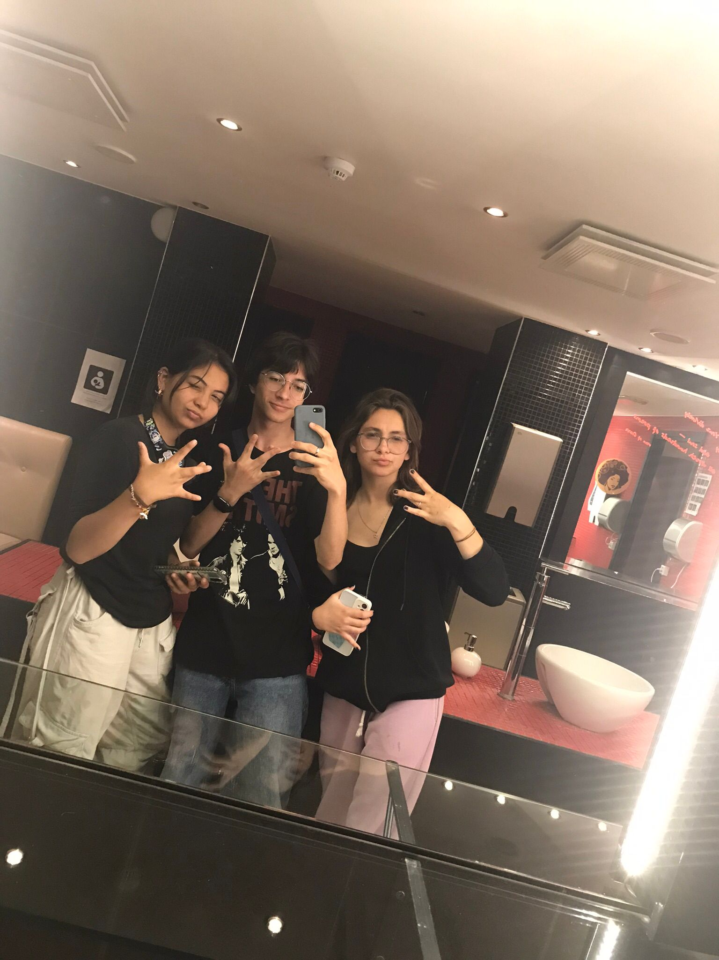
Our Personal Experiences

Slide 19
Project Products
Project Games
https://actionbound.com/bound/healthy-or-polluted-environment
https://www.jigsawplanet.com/?rc=play&pid=2610e4647686
https://create.kahoot.it/share/healthy-or-polluted-environment/e40c842c-15f7-435e-9c8a-a185c1e4f84a
https://actionbound.com/bound/after-environment
https://en.actionbound.com/bound/industrialization-and-waste

Slide 20
Project
Project Song
https://youtu.be/BtUFPTLfgOk
Project Films
https://youtu.be/SKhs1q6TiDU
https://youtu.be/V13Drci9jT4
eBook
https://www.storyjumper.com/book/read/173106931

